Slide 1
INTEL UNNATI
INDUSTRIAL TRAINING PROGRAMME 2024
TEAM NAME | GeoSym
UNIVERSITY | Christ (Deemed to be University)
INTERNAL MENTOR | Ravindra Singh
EXTERNAL MENTOR | Amartya Saikia

Slide 2
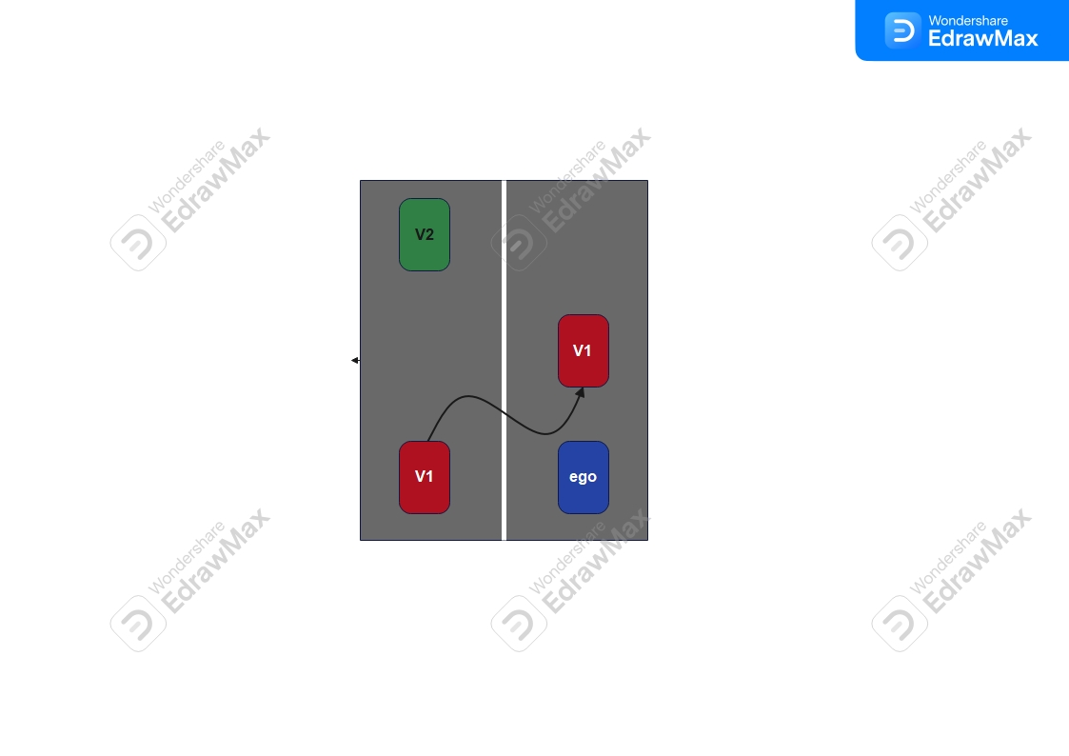
PROBLEM STATEMENT
PS-8: VEHICLE CUT IN DETECTION
Detection of sudden cut-in of vehicles (two/ three/ four wheelers etc.) into the direction of driving.

Slide 3
UNIQUE IDEA
Our model integrates visual and spatial data to enhance prediction accuracy and provide actionable insights.
By fusing image-based object detection with location-based trajectory estimation, we generate precise object bounding boxes and estimate time-to-collision.
This multimodal approach offers a more comprehensive understanding of the dynamic environment, enabling proactive decision-making compared to traditional methods reliant solely on static thresholds.
GitHub Link: https://github.com/GeoSym/Vehicle_CutIn

Slide 4
FEATURES OFFERED
The features used to train the collision prediction model are:
Latitude: Geographical latitude of the vehicle.
Longitude: Geographical longitude of the vehicle.
Speed: The speed of the vehicle.
Time to Collision (TTC): The estimated time until a potential collision with another vehicle.
These features are used as input to a neural network model, which is trained to predict the likelihood of a collision.

Slide 5
PROCESS FLOW
The process flow of the provided code is broken down into the following steps:
1. Environment Setup and Data Loading:
Install necessary libraries (TensorFlow, OpenCV, etc.).
Mount Google Drive to access data.
Download and load a pre-trained object detection model.
Load images and a CSV file containing location and timestamp data.
2. Object Detection and Image Processing:
Iterate through images in a directory.
Load each image into a NumPy array.
Run object detection on the image using the pre-trained model.
Draw bounding boxes around detected objects and display the annotated image.

Slide 6
PROCESS FLOW
3. Data Preprocessing and Feature Engineering:
Convert timestamps to datetime objects and sort the data.
Calculate distances between consecutive geographical points.
Calculate time intervals between consecutive timestamps.
Estimate speeds based on distances and time intervals.
Calculate Time to Collision (TTC) for each pair of consecutive data points.
Handle potential infinite or negative TTC values.
Label data points as collision (1) or non-collision (0) based on a TTC threshold.
Standardize features using a StandardScaler.
4. Model Training and Evaluation:
Split the data into training and testing sets.
Define a neural network model with dense layers and a sigmoid activation for binary classification.
Compile the model with an Adam optimizer and binary cross entropy loss.
Train the model on the training data.
Evaluate the model's accuracy on the testing data.

Slide 7
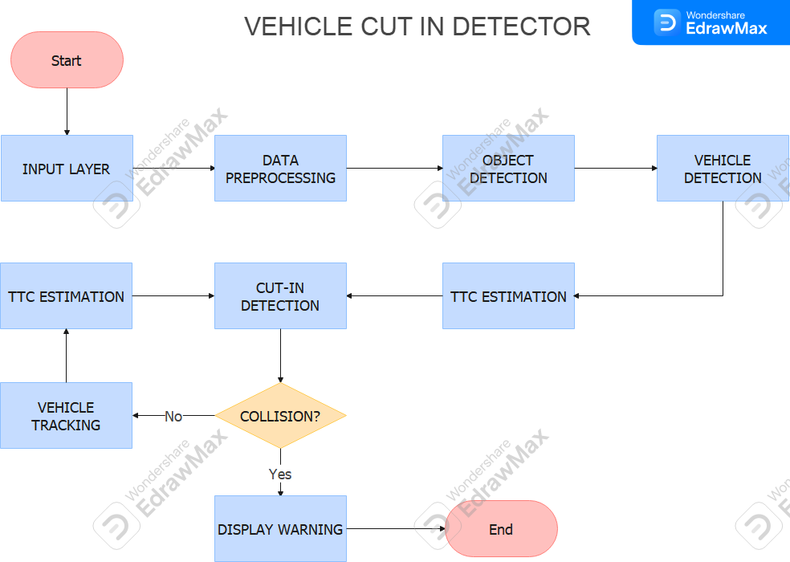
ARCHITECTURE DIAGRAM

Slide 8
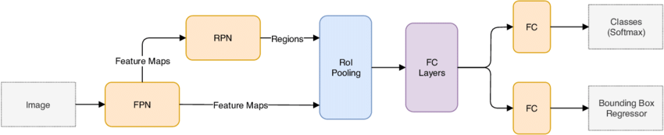
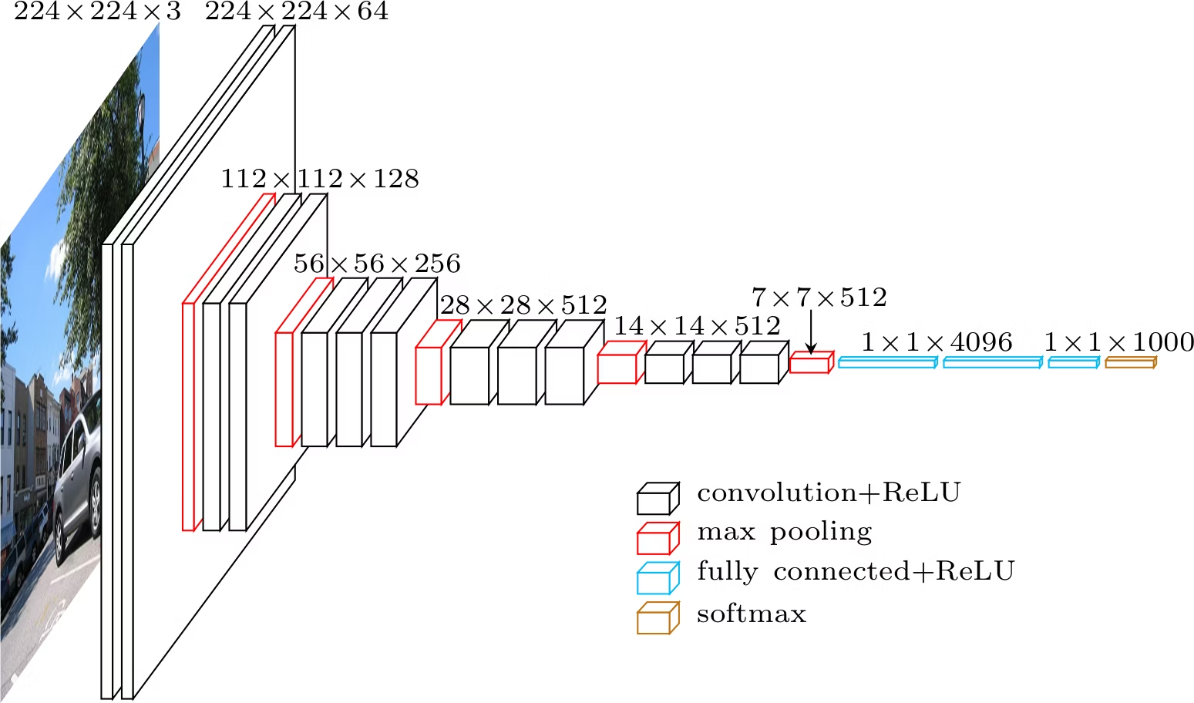
FAST RCNN INCEPTION RESNET V2

Slide 9
TECHNOLOGIES USED
Libraries:
TensorFlow: Used for object detection and building a neural network.
OpenCV: Used for image processing and computer vision tasks.
Pandas: Used for data analysis and manipulation.
NumPy: Used for numerical operations and array manipulation.
Geopy: Used for calculating distances between geographical coordinates.
Matplotlib: Used for creating static, interactive, and animated visualizations in Python.
Scikit-learn: Used for machine learning tasks such as data preprocessing, model selection, and evaluation.
Altair: Used for declarative statistical visualization.
Seaborn:Used for visual statistical analysis
Other:
Google Colab: The environment the code is running in, providing access to GPUs and TPUs.
Google Drive: Used for storing and accessing data.
Object Detection API: A collection of pre-trained models and utilities for object detection tasks

Slide 10
TEAM MEMBERS AND CONTRIBUTIONS
TEAM MEMBER | CONTRIBUTION
OSWIN BIJU CHACKO | Distance estimation TTC estimation Model pipeline
AUGUSTIAN JAISON | Vehicle detection Bounding box annotation
MEGHA RAJESH KANDANGATH | Data visualization and normalization Model evaluation Model Testing
ADARSH ANIL | Unity simulation
DONA MARIA SIJU | Unity simulation

Slide 11
CONCLUSION
The proposed vehicle cut-in detection model demonstrates promising performance in accurately identifying cut-in events under various driving conditions.
The model achieves a high detection rate with a low false positive rate, making it suitable for real-time applications.
However, challenges remain in handling occlusions and extreme weather conditions.
Future research should focus on enhancing robustness and exploring the integration of the model into advanced driver assistance systems for improved road safety.

